Slide 1

Why dogs make the best programmers
Hannah Ellicott

Slide 2
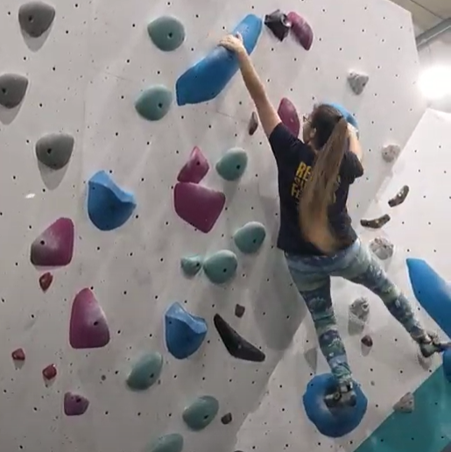
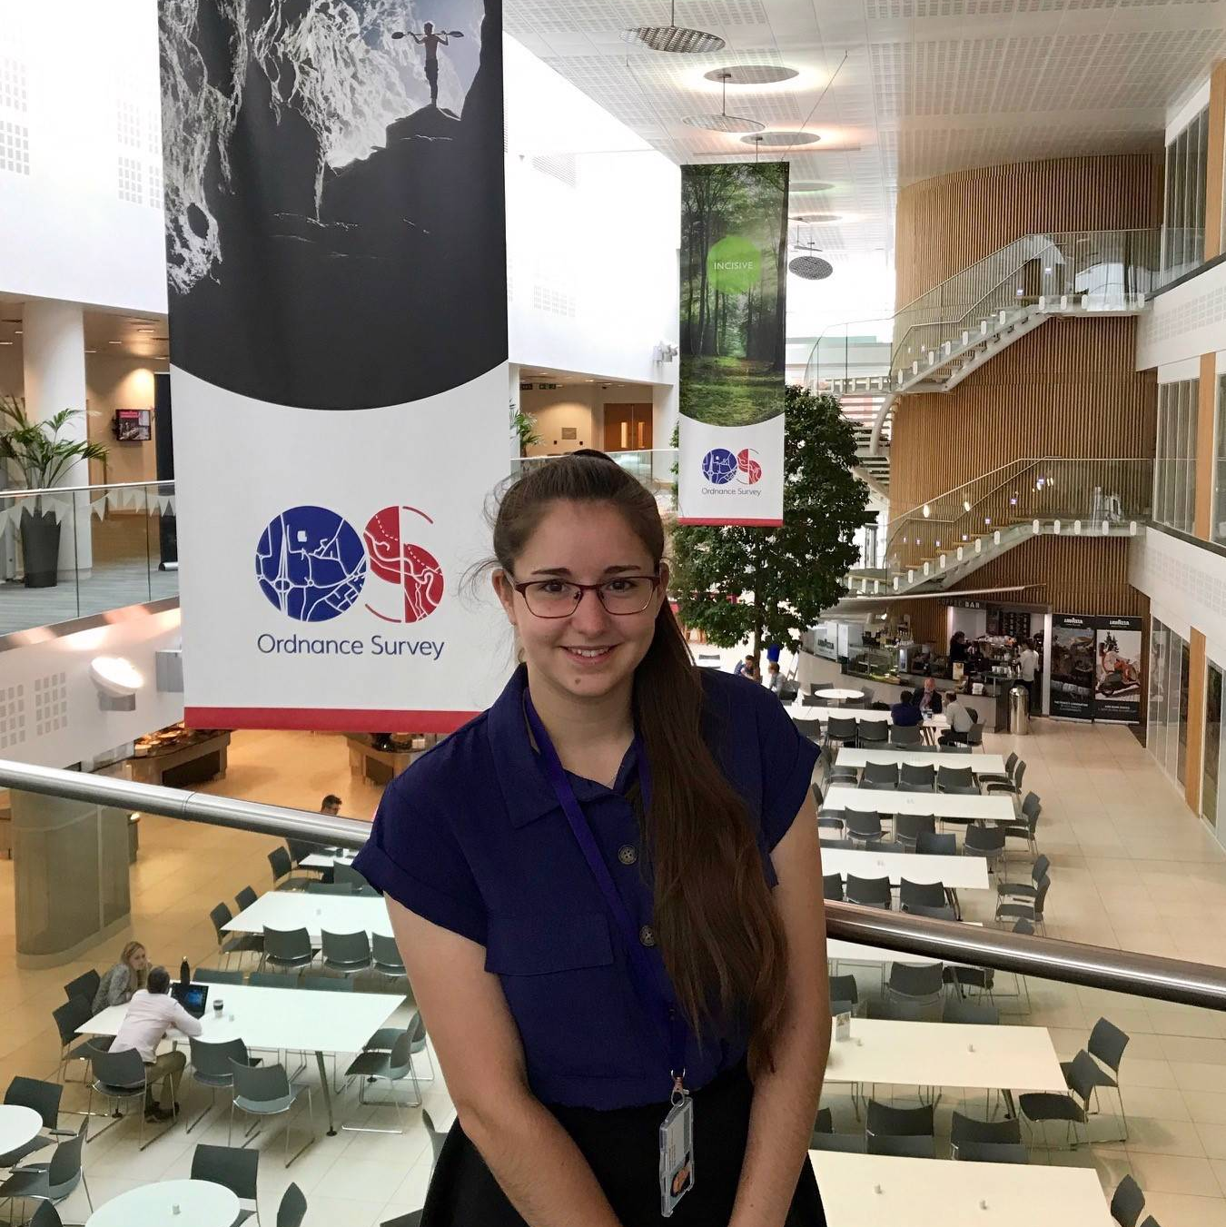
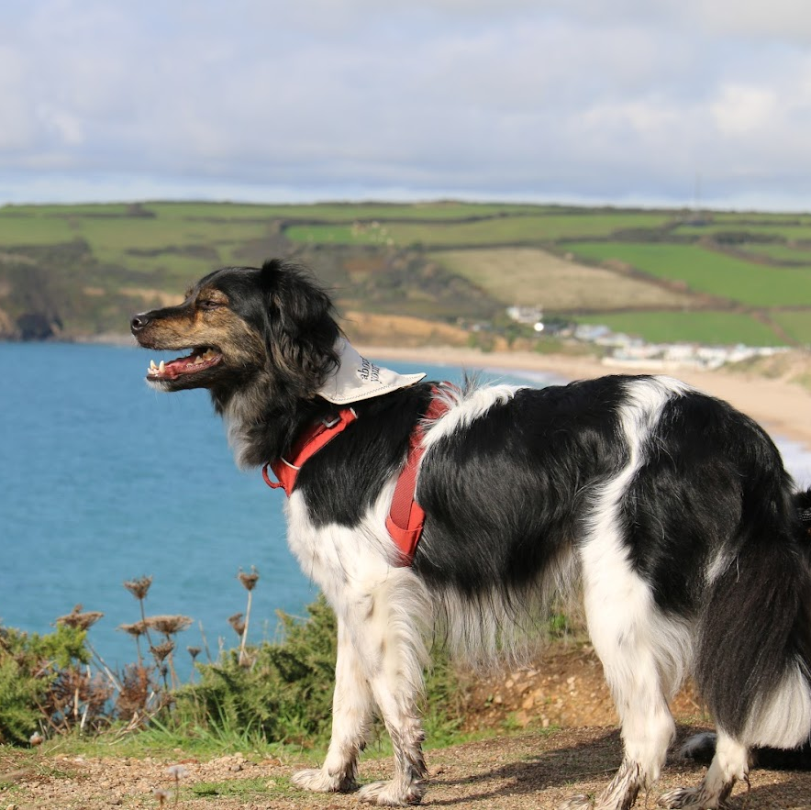
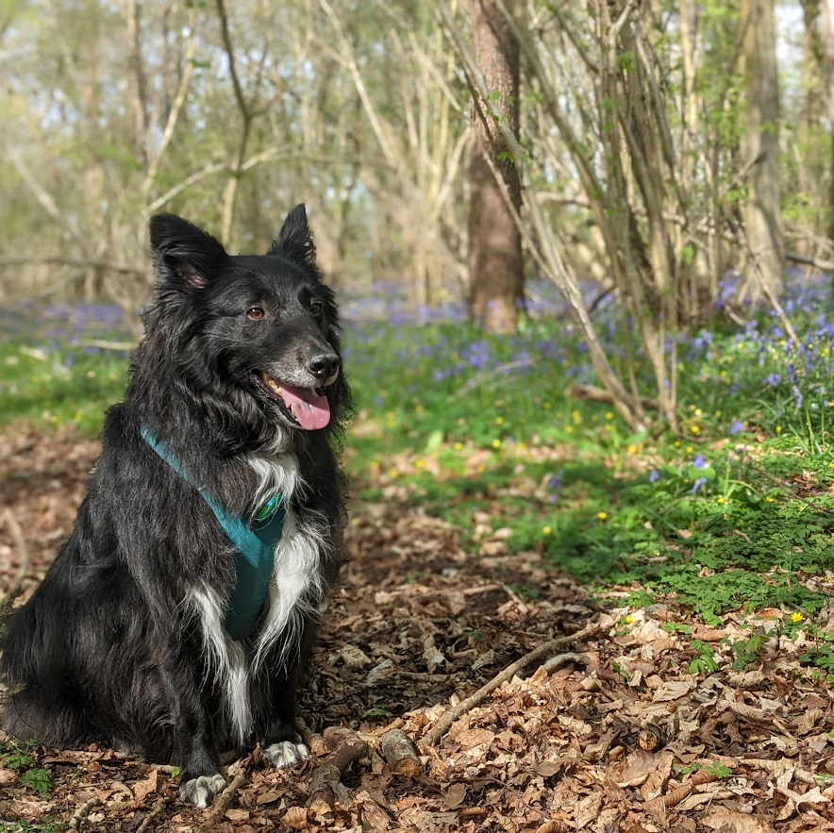
Hannah Ellicott
Software Engineer
Climbing Instructor
Dog lover

Slide 3


Agenda
How are dogs and programming connected?
Code Smells
Dispensables
Bloaters
Couplers
10 mins
Q&A
5 mins

Slide 4
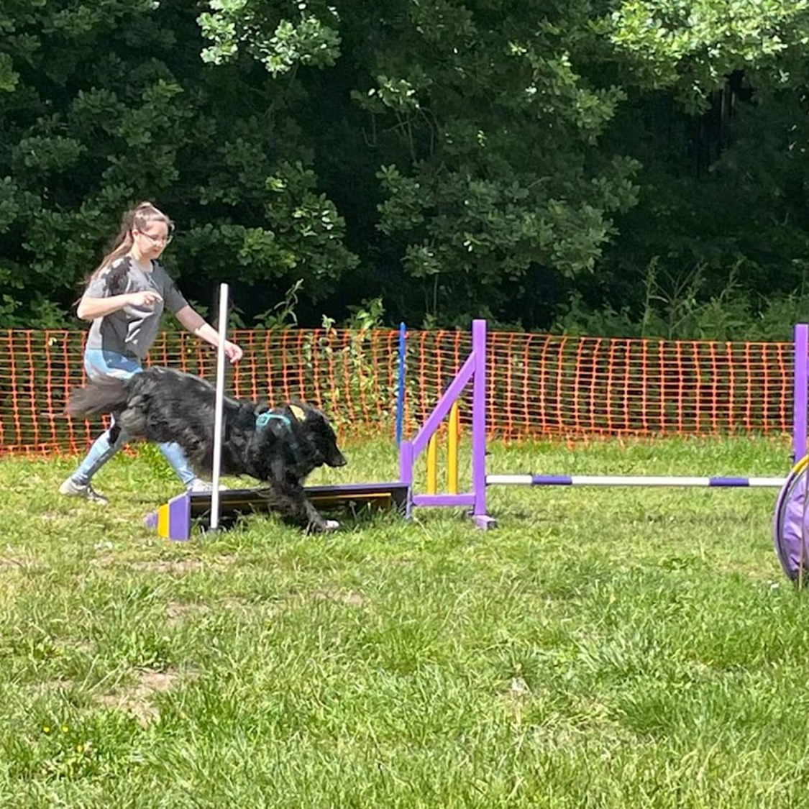
How are dogs and programming connected?
Training
Patience
Time
Problem Solving
Maintenance

Slide 5
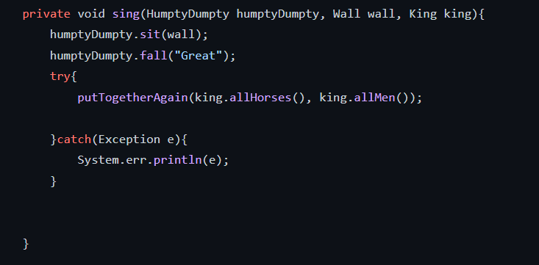
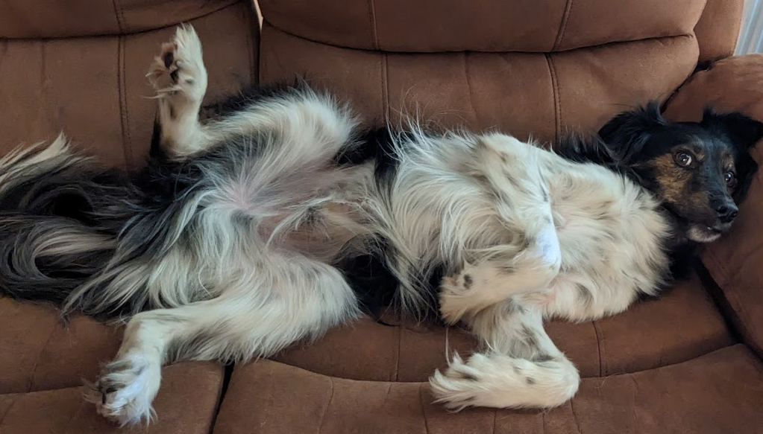
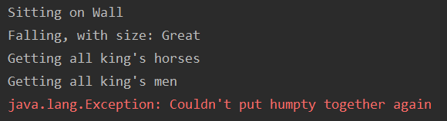
Communicating Intent
Clear
Concise
Consistent
Full Code: https://github.com/hellicott/codemanship#humpty-dumpty

Slide 6
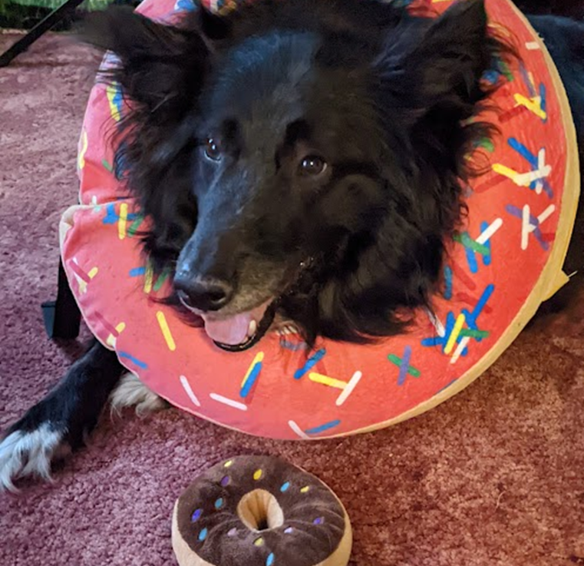
Code Smells

Slide 7
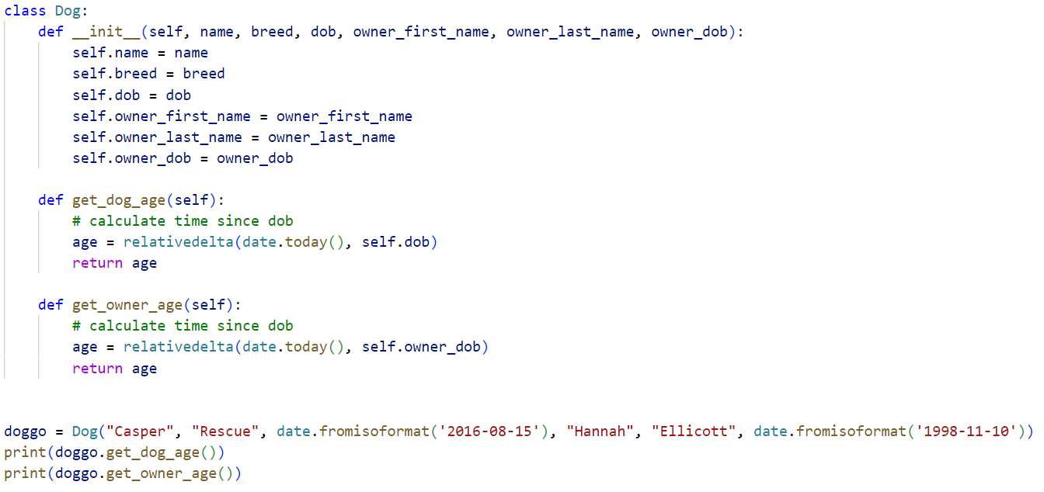
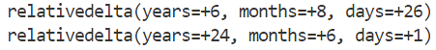

Slide 8
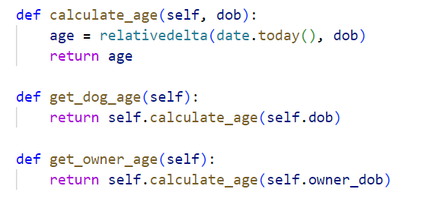
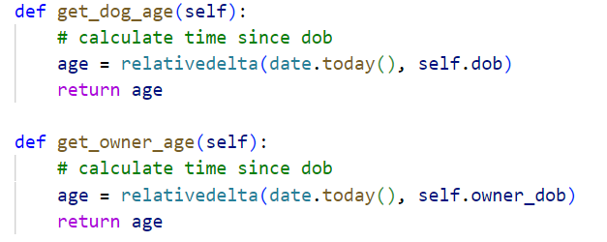
Dispensables
Comments
Duplicates
Unused Code

Slide 9
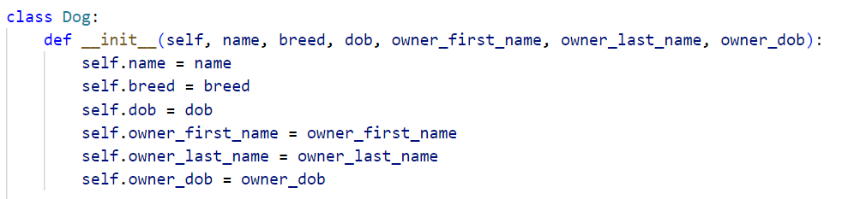
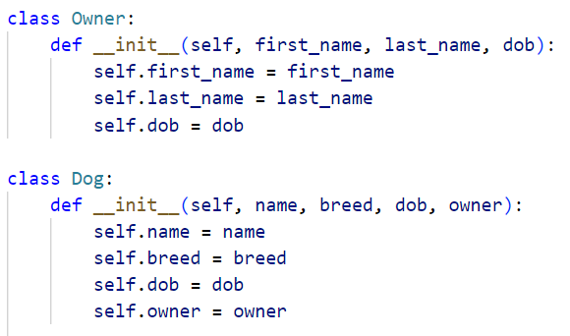

Bloaters
Many parameters
Long methods
Primitive types

Slide 10
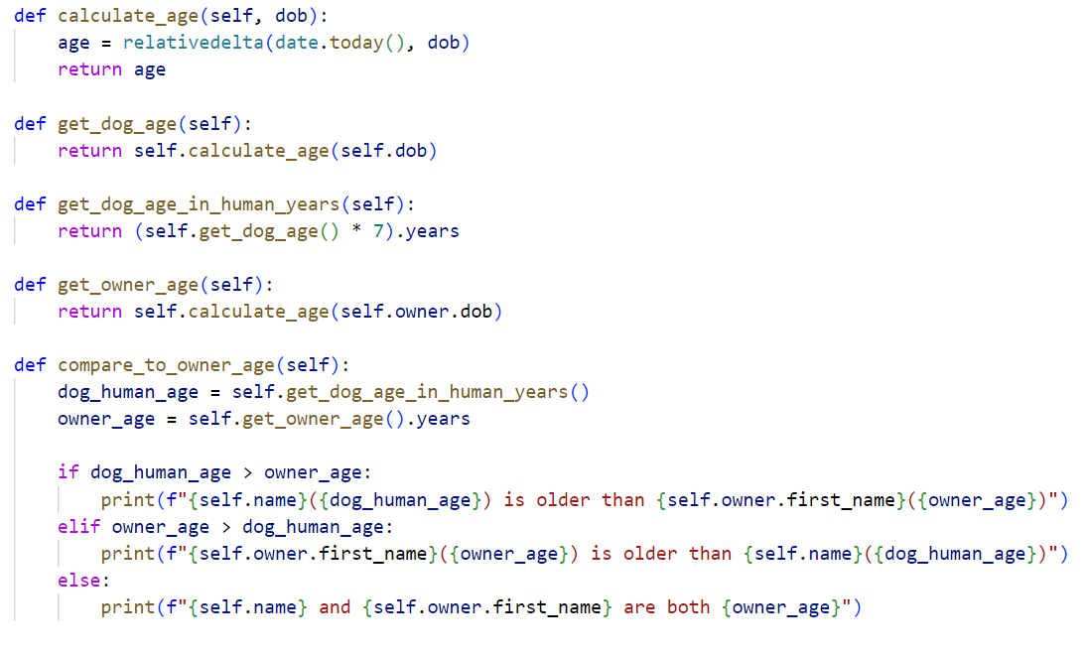
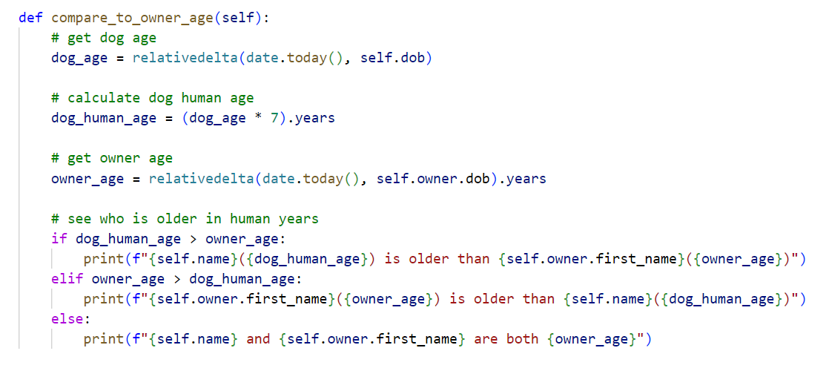
Bloaters
Many parameters
Long methods
Primitive types

Slide 11
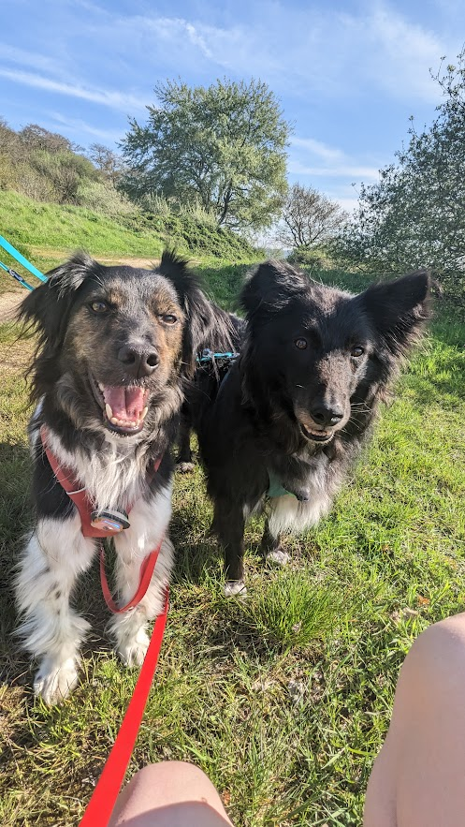
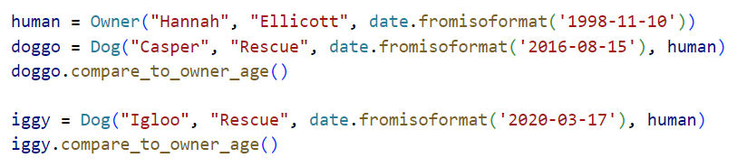
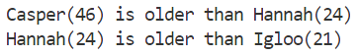

Slide 12
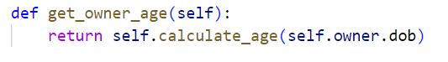
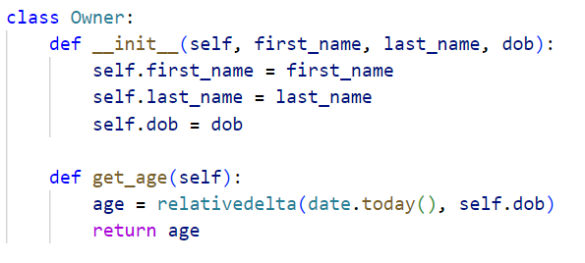
Couplers
Feature envy
Accessing internal fields

Slide 13
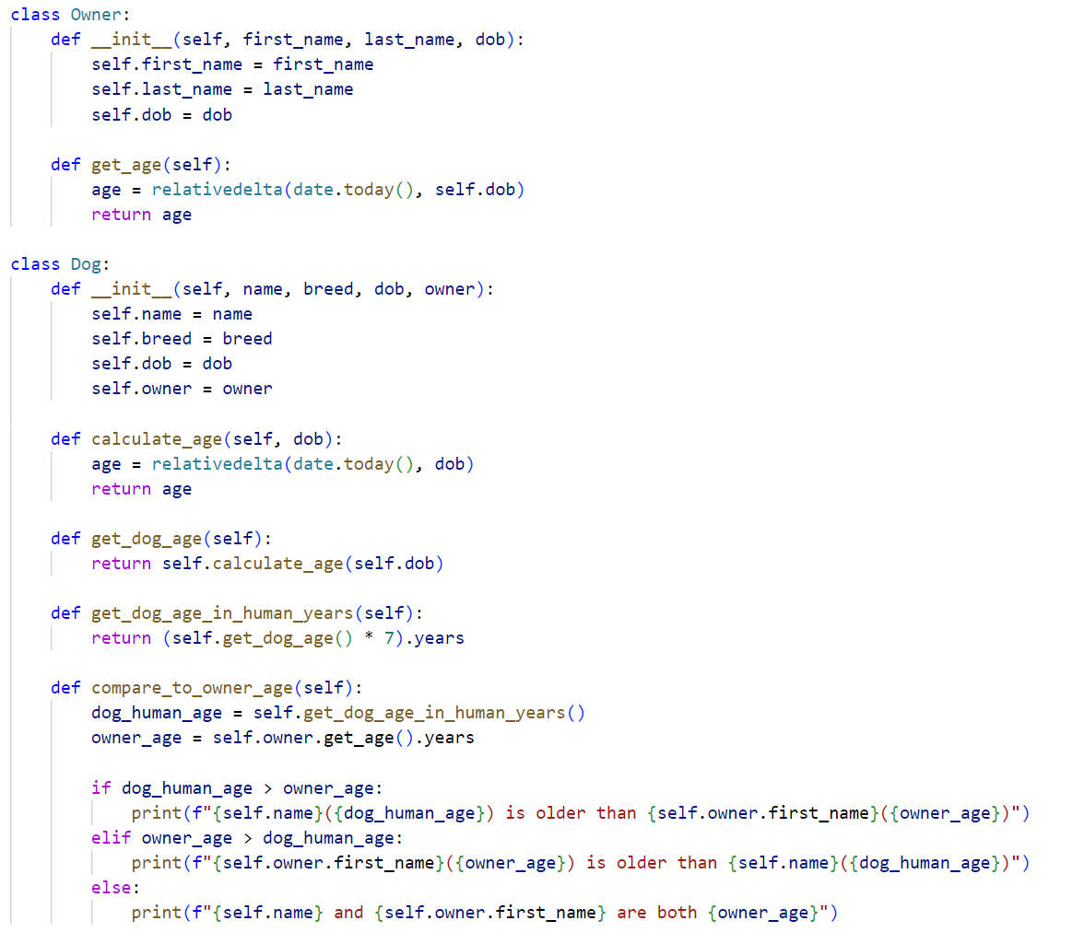

Slide 14
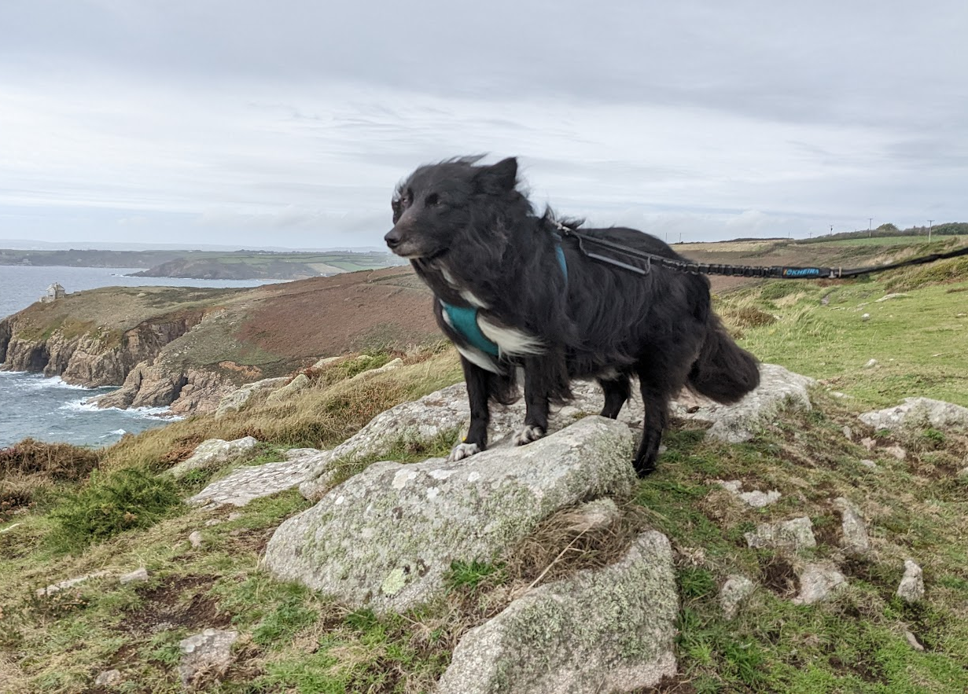
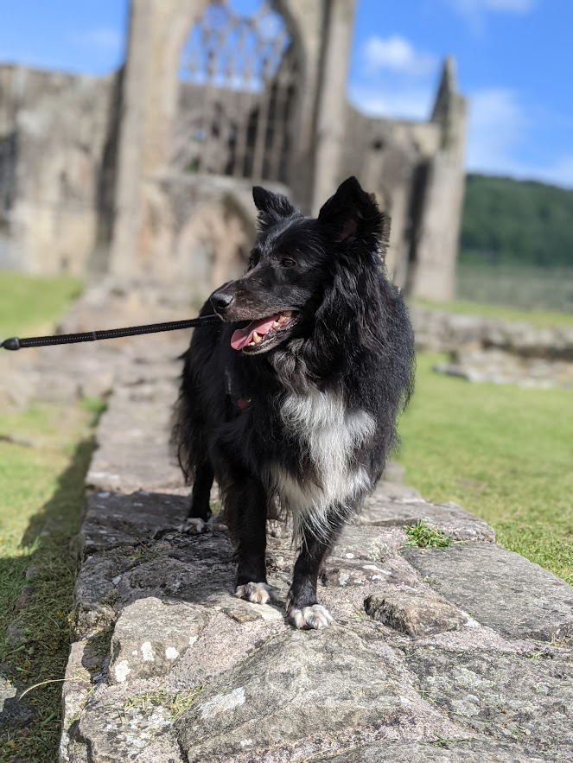
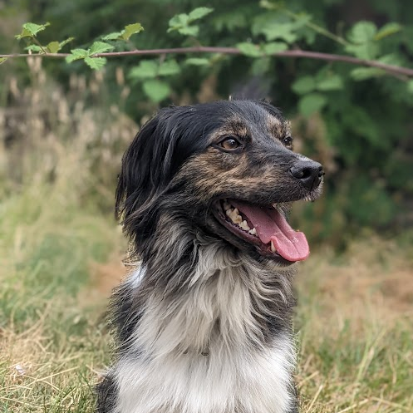
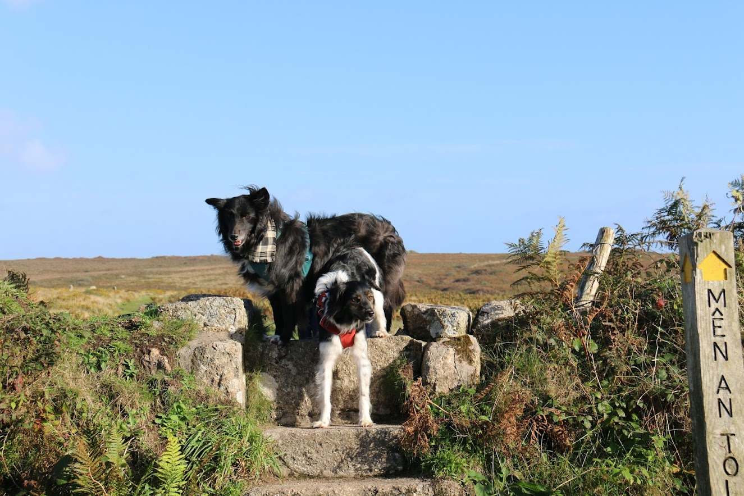
Joy

Slide 15
Recap
How are dogs and programming connected?
Code Smells
Dispensables
Bloaters
Couplers
10 mins
Q&A
5 mins

Slide 16
Q+A

Slide 17


Thank you!
For more info:
https://refactoring.guru/refactoring/smells
hannah.ellicott@os.uk
github.com/hellicott

